Slide 1
Model Selection and Training
Dr. Sugata Ghosal
CSIS Off-Campus Faculty
BITS Pilani

Slide 2
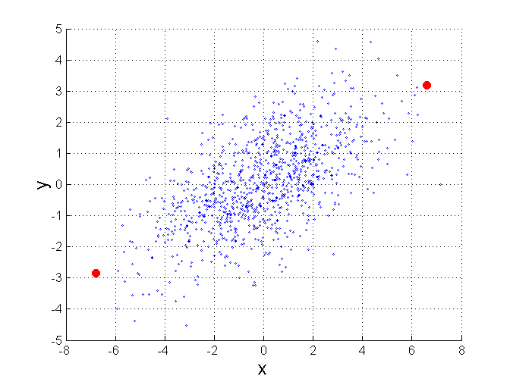
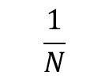
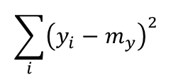
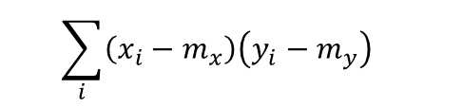
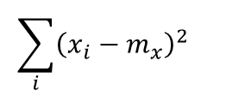
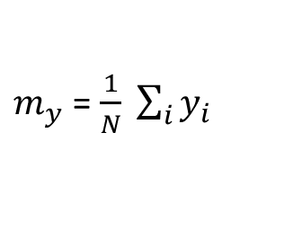
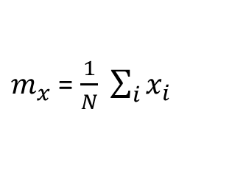
Mahalanobis Distance
$mahalanobis\left(x,y\right)={ ((x−y)}^{T}Ʃ^{−1}(x−y))$^{-0.5}
Σ is the covariance matrix
$$\sum_{i}{{\left(x_{i}−m_{x}\right)}^{2} }$$
$$\sum_{i}{{\left(x_{i}−m_{x}\right)\left(y_{i}−m_{y}\right)}^{ } }$$
$$\frac{1}{N}$$
$$\sum_{i}{{\left(x_{i}−m_{x}\right)\left(y_{i}−m_{y}\right)}^{ } }$$
$$\sum_{i}{{\left(y_{i}−m_{y}\right)}^{2} }$$
$m_{x}$ = $\frac{1}{N} \sum_{i}{x_{i}}$
$m_{y}$ = $\frac{1}{N} \sum_{i}{y_{i}}$
For red points, the Euclidean distance is 14.7, Mahalanobis distance is 6.

Slide 3
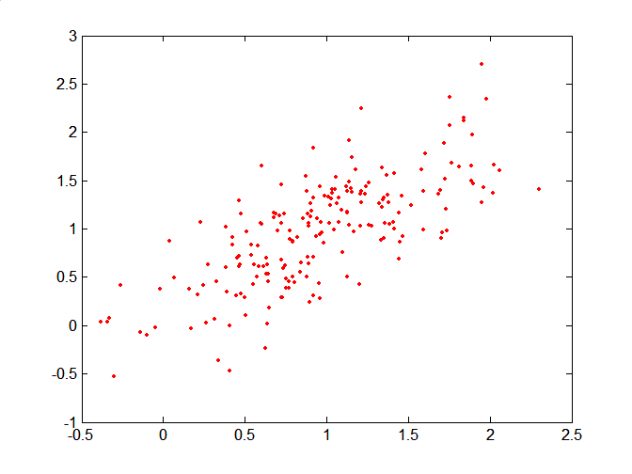
Mahalanobis Distance
Covariance Matrix:
C
A: (0.5, 0.5)
B: (0, 1)
C: (1.5, 1.5)
Mahal(A,B) = 5
Mahal(A,C) = 4
B
A

Slide 4
Common Properties of a Distance
Distances, such as the Euclidean distance, have some well known properties.
d(x, y) ≥ 0 for all x and y and d(x, y) = 0 if and only if x = y.
d(x, y) = d(y, x) for all x and y. (Symmetry)
d(x, z) ≤ d(x, y) + d(y, z) for all points x, y, and z. (Triangle Inequality)
where d(x, y) is the distance (dissimilarity) between points (data objects), x and y.
A distance that satisfies these properties is a metric

Slide 5
Similarity Between Binary Vectors
Common situation is that objects, x and y, have only binary attributes
Compute similarities using the following quantities
f₀₁ = the number of attributes where x was 0 and y was 1
f₁₀ = the number of attributes where x was 1 and y was 0
f₀₀ = the number of attributes where x was 0 and y was 0
f₁₁ = the number of attributes where x was 1 and y was 1
Simple Matching and Jaccard Coefficients
SMC = number of matches / number of attributes
= (f₁₁ + f₀₀) / (f₀₁ + f₁₀ + f₁₁ + f₀₀)
J = number of 11 matches / number of non-zero attributes
= (f₁₁) / (f₀₁ + f₁₀ + f₁₁)

Slide 6
SMC versus Jaccard: Example
x = 1 0 0 0 0 0 0 0 0 0
y = 0 0 0 0 0 0 1 0 0 1
f₀₁ = 2 (the number of attributes where x was 0 and y was 1)
f₁₀ = 1 (the number of attributes where x was 1 and y was 0)
f₀₀ = 7 (the number of attributes where x was 0 and y was 0)
f₁₁ = 0 (the number of attributes where x was 1 and y was 1)
SMC = (f₁₁ + f₀₀) / (f₀₁ + f₁₀ + f₁₁ + f₀₀)
= (0+7) / (2+1+0+7) = 0.7
J = (f₁₁) / (f₀₁ + f₁₀ + f₁₁) = 0 / (2 + 1 + 0) = 0

Slide 7
Cosine Similarity
If d₁ and d₂ are two document vectors, then
cos( d₁, d₂ ) = <d₁,d₂> / ||d₁|| ||d₂|| ,
where <d₁,d₂> indicates inner product or vector dot product of vectors, d₁ and d_{2,} and || d || is the length of vector d.
Example:
d₁ = 3 2 0 5 0 0 0 2 0 0
d₂ = 1 0 0 0 0 0 0 1 0 2
<d₁, d2> = 3*1 + 2*0 + 0*0 + 5*0 + 0*0 + 0*0 + 0*0 + 2*1 + 0*0 + 0*2 = 5
| d₁ || = (3*3+2*2+0*0+5*5+0*0+0*0+0*0+2*2+0*0+0*0)^{0.5} = (42) ^{0.5} = 6.481
|| d₂ || = (1*1+0*0+0*0+0*0+0*0+0*0+0*0+1*1+0*0+2*2) ^{0.5} = (6) ^{0.5} = 2.449
cos(d₁, d₂ ) = 0.3150

Slide 8
Common Properties of a Similarity
Similarities, also have some well known properties.
s(x, y) = 1 (or maximum similarity) only if x = y. (does not always hold, e.g., cosine)
s(x, y) = s(y, x) for all x and y. (Symmetry)
where s(x, y) is the similarity between points (data objects), x and y.

Slide 9
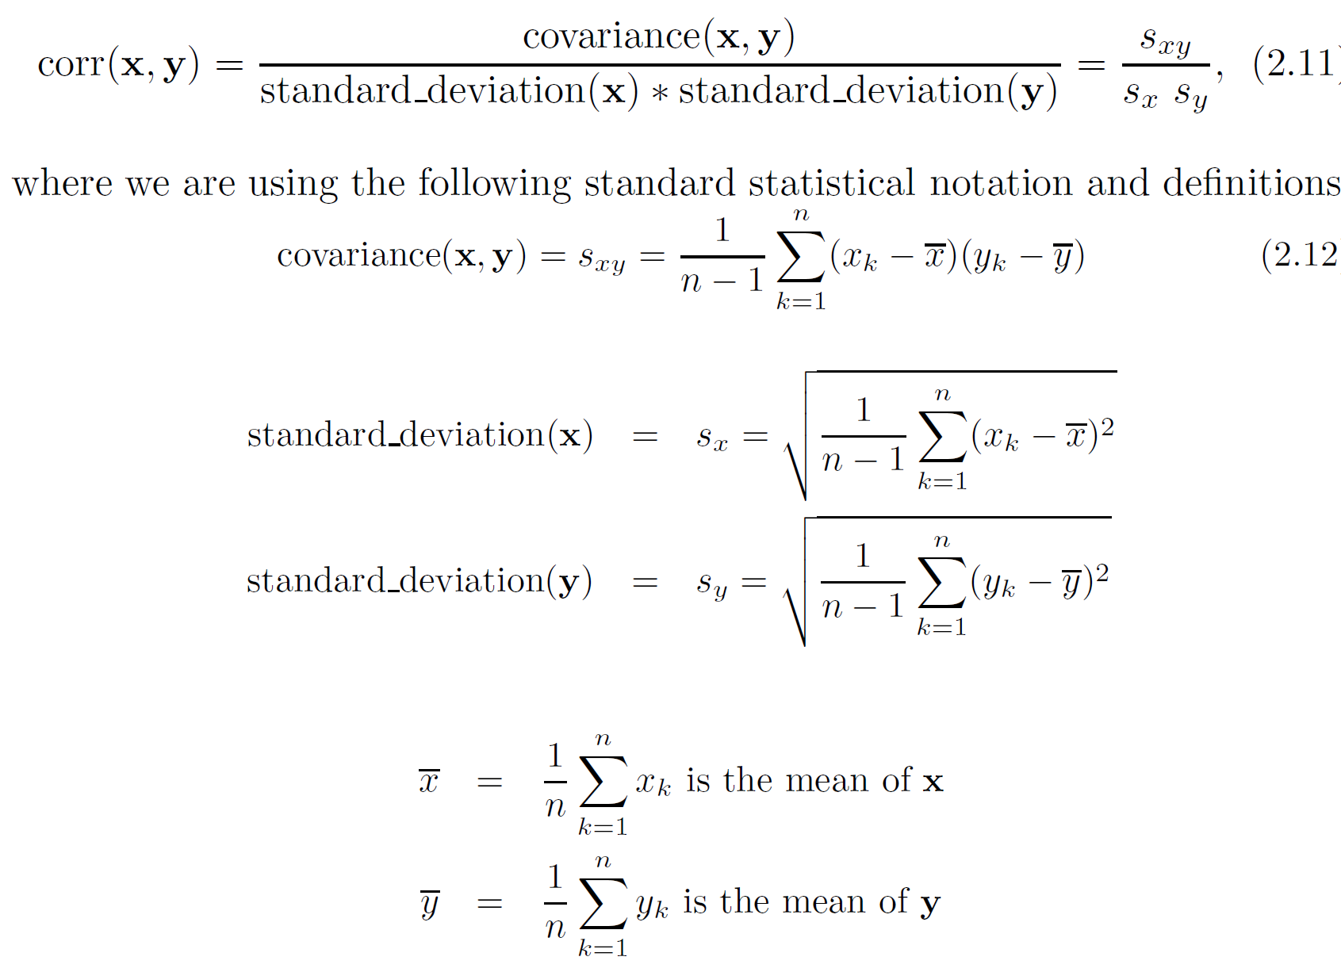
Correlation measures the linear relationship between objects

Slide 10
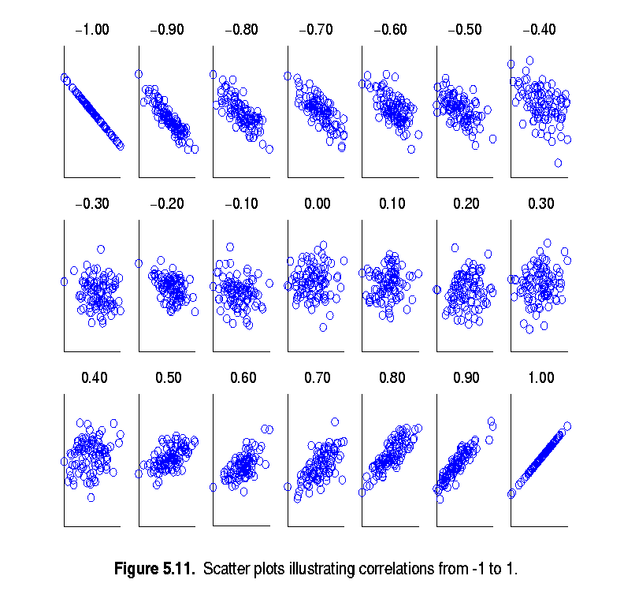
Visually Evaluating Correlation
Scatter plots showing the similarity from –1 to 1.

Slide 11
Drawback of Correlation
x = (-3, -2, -1, 0, 1, 2, 3)
y = (9, 4, 1, 0, 1, 4, 9)
y_{i} = x_{i}²
mean(x) = 0, mean(y) = 4
std(x) = 2.16, std(y) = 3.74
corr = (-3)(5)+(-2)(0)+(-1)(-3)+(0)(-4)+(1)(-3)+(2)(0)+3(5) / ( 6 * 2.16 * 3.74 )
= 0

Slide 12
Correlation vs Cosine vs Euclidean Distance
Compare the three proximity measures according to their behavior under variable transformation
scaling: multiplication by a value
translation: adding a constant
Consider the example
x = (1, 2, 4, 3, 0, 0, 0), y = (1, 2, 3, 4, 0, 0, 0)
y_{s} = y * 2 (scaled version of y), y_{t} = y + 5 (translated version)
Property | Cosine | Correlation | Euclidean Distance
Invariant to scaling (multiplication) | Yes | Yes | No
Invariant to translation (addition) | No | Yes | No
Measure | (x , y) | (x , y_{s}) | (x , y_{t})
Cosine | 0.9667 | 0.9667 | 0.7940
Correlation | 0.9429 | 0.9429 | 0.9429
Euclidean Distance | 1.4142 | 5.8310 | 14.2127

Slide 13
Correlation vs cosine vs Euclidean distance
Choice of the right proximity measure depends on the domain
What is the correct choice of proximity measure for the following situations?
Comparing documents using the frequencies of words
Documents are considered similar if the word frequencies are similar
Comparing the temperature in Celsius of two locations
Two locations are considered similar if the temperatures are similar in magnitude
Comparing two time series of temperature measured in Celsius
Two time series are considered similar if their “shape” is similar, i.e., they vary in the same way over time, achieving minimums and maximums at similar times, etc.

Slide 14
Comparison of Proximity Measures
Domain of application
Similarity measures tend to be specific to the type of attribute and data
Record data, images, graphs, sequences, 3D-protein structure, etc. tend to have different measures
However, one can talk about various properties that you would like a proximity measure to have
Symmetry is a common one
Tolerance to noise and outliers is another
Ability to find more types of patterns?
Many others possible
The measure must be applicable to the data and produce results that agree with domain knowledge

Slide 15
Thank You!
In our next segment: Visualization

Slide 16
In this segment
Data Visualization
Visualization Plots
Histogram
Boxplot
Contour
Scatter Plot
Matrix Plots
Correlation Plots

Slide 17
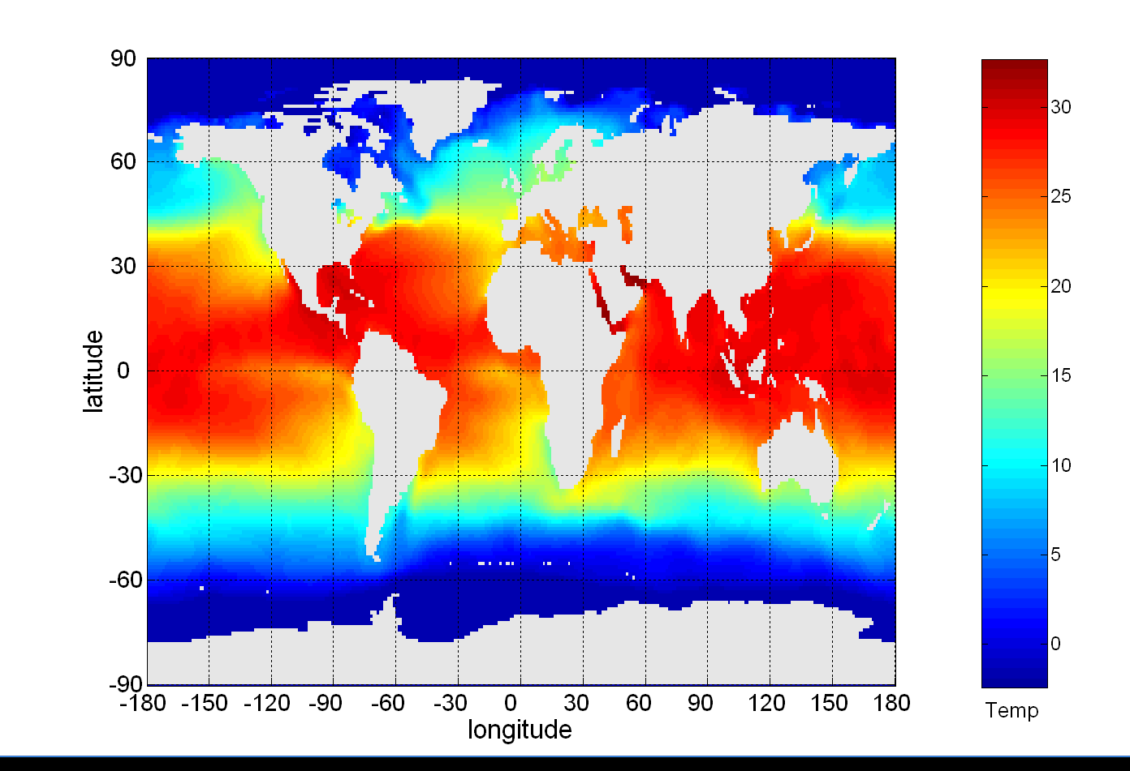
Visualization
Conversion of data into a visual or tabular format
Visualization of data is one of the most powerful and appealing techniques for data exploration.
Humans have a well developed ability to analyze large amounts of information that is presented visually
Can detect general patterns and trends
Can detect outliers and unusual patterns
Data objects, their attributes, and the relationships among data objects are translated into graphical elements such as points, lines, shapes, and colors.
Example:
Objects are often represented as points
Their attribute values can be represented as the position of the points or the characteristics of the points, e.g., color, size, and shape
Sea Surface Temperature (SST) for July 1982

Slide 18
Representation
Mapping information to a visual format
Data objects, their attributes, and the relationships among data objects are translated into graphical elements such as points, lines, shapes, and colors.
Example:
Objects are often represented as points
Their attribute values can be represented as the position of the points or the characteristics of the points, e.g., color, size, and shape
If position is used, then the relationships of points, i.e., whether they form groups or a point is an outlier, is easily perceived.

Slide 19
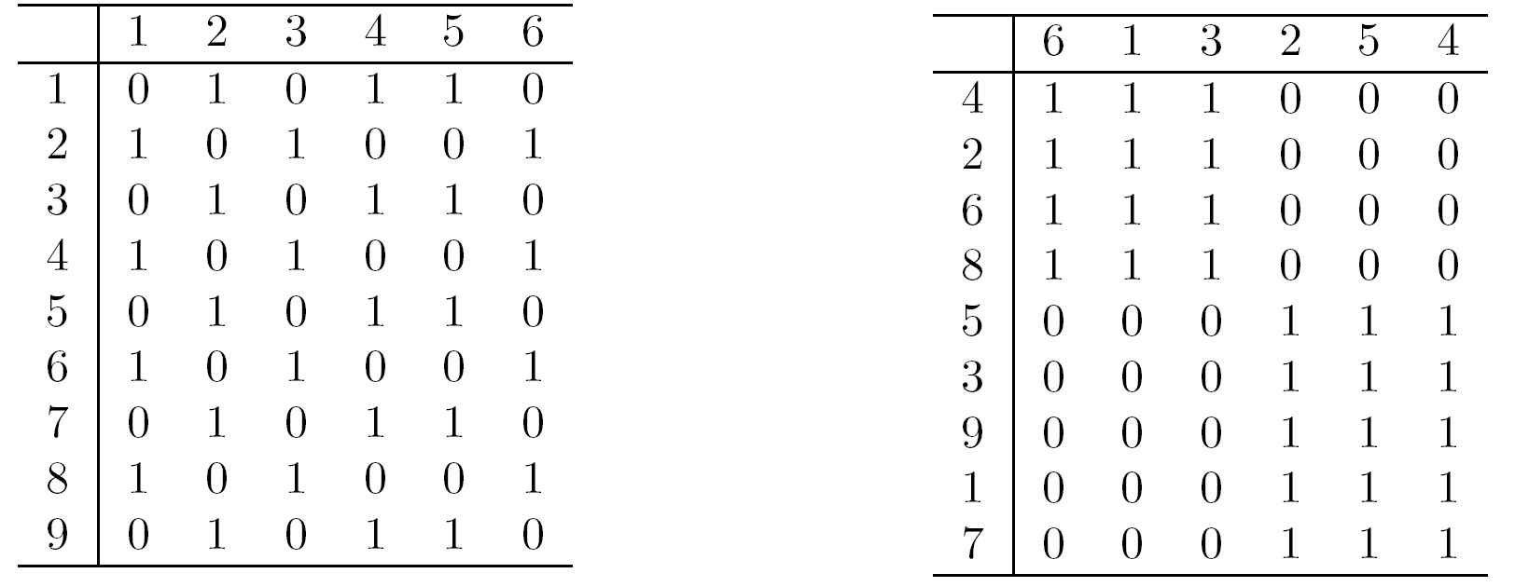
Arrangement
Placement of visual elements within a display
Is the Can make a large difference in how easy it is to understand the data
Example:

Slide 20
Selection
Elimination or the de-emphasis of certain objects and attributes
Selection may involve the choosing a subset of attributes
Dimensionality reduction is often used to reduce the number of dimensions to two or three
Alternatively, pairs of attributes can be considered
Selection may also involve choosing a subset of objects
A region of the screen can only show so many points
Can sample, but want to preserve points in sparse areas

Slide 21
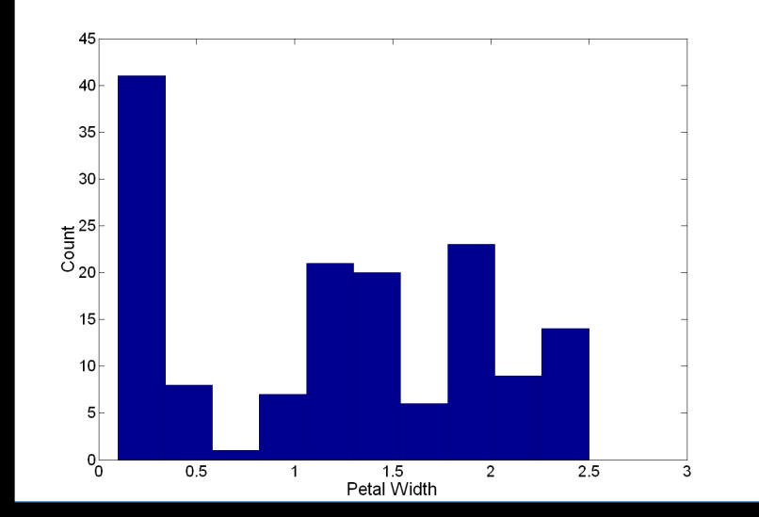
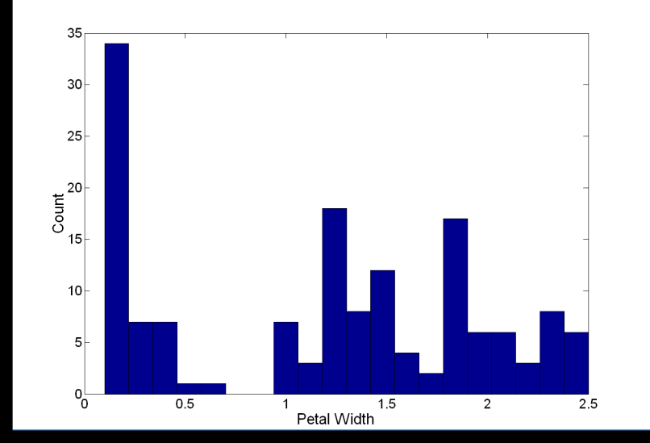
Visualization Techniques: Histograms
Histogram
Usually shows the distribution of values of a single variable
Divide the values into bins and show a bar plot of the number of objects in each bin.
The height of each bar indicates the number of objects
Shape of histogram depends on the number of bins
Example: Petal Width (10 and 20 bins, respectively)

Slide 22
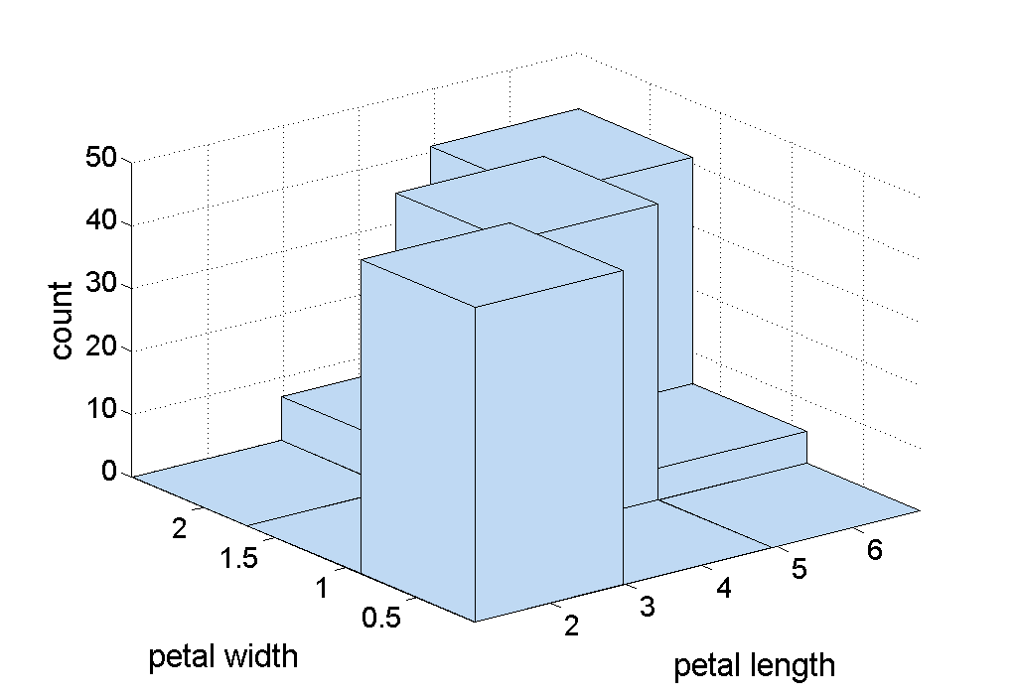
Two-Dimensional Histograms
Show the joint distribution of the values of two attributes
Example: petal width and petal length

Slide 23
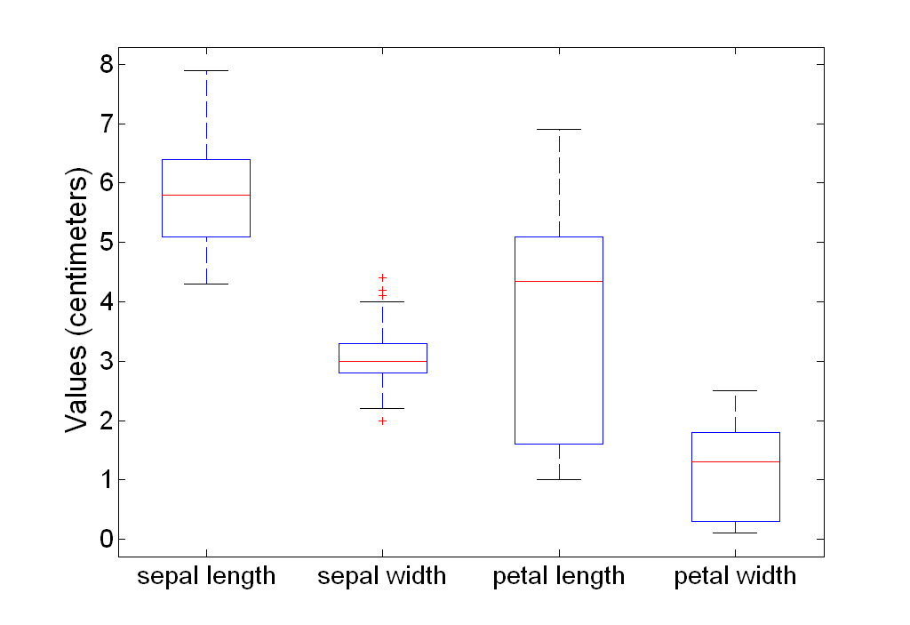
Visualization Techniques: Box Plots
Display distribution of data
outlier
90th percentile
75th percentile
50th percentile
25th percentile
10th percentile

Slide 24
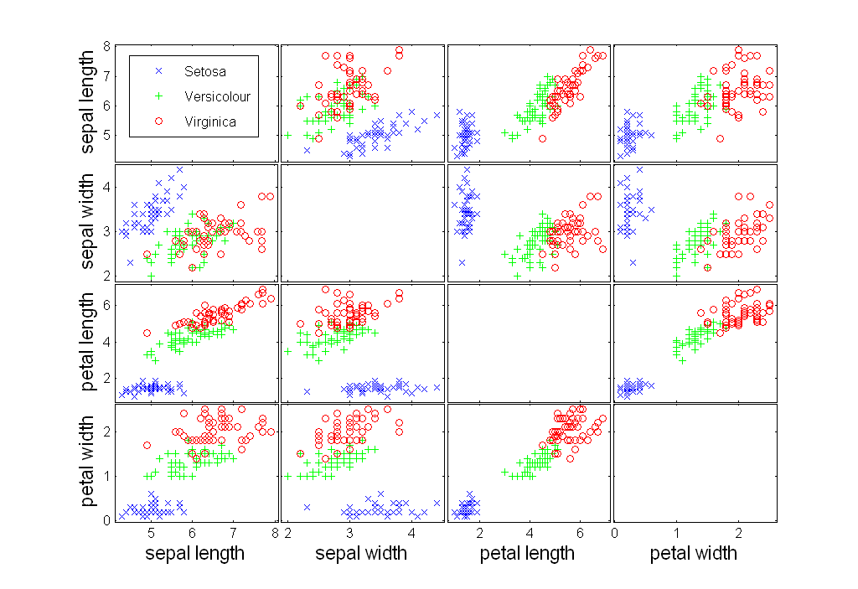
Visualization Techniques: Scatter Plots
Attributes values determine the position
Scatter plots can compactly summarize the relationships of several pairs of attributes
Example: Iris Plant dataset http://www.ics.uci.edu/~mlearn/MLRepository.html
Three flower types (classes): Setosa, Versicolour, Virginica
Four (non-class) attributes: Sepal width and length, Petal width and length

Slide 25
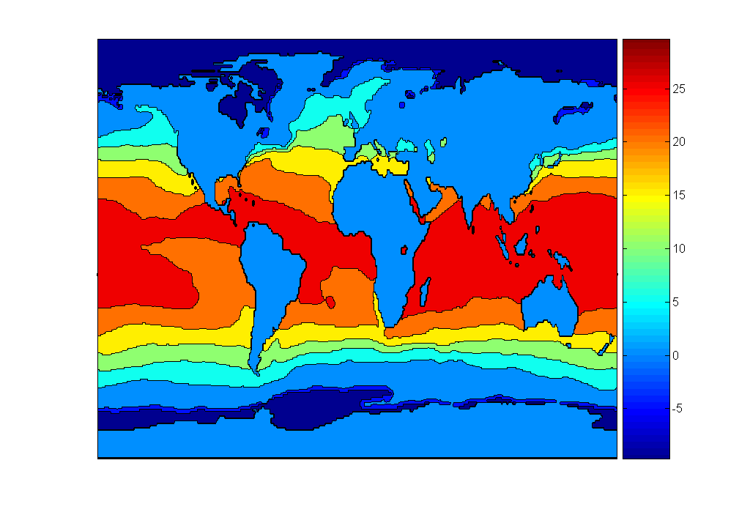
Visualization Techniques: Contour Plots
Continuous attribute is measured on a spatial grid
Useful when a They partition the plane into regions of similar values
The contour lines that form the boundaries of these regions connect points with equal values
Common example: contour maps of elevation, temperature, rainfall, air pressure, etc.
Celsius
Surface Sea Temperature

Slide 26
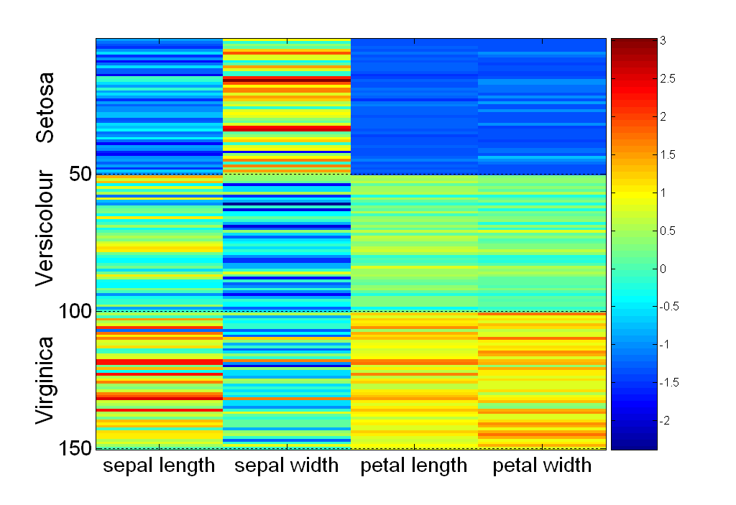
Visualization Techniques: Matrix Plots
Plot data matrix
Often useful when objects are sorted according to class
Plots of similarity or distance matrices can also be useful for visualizing the relationships
standard
deviation

Slide 27
Visualization of the Iris Data Matrix
standard
deviation

Slide 28
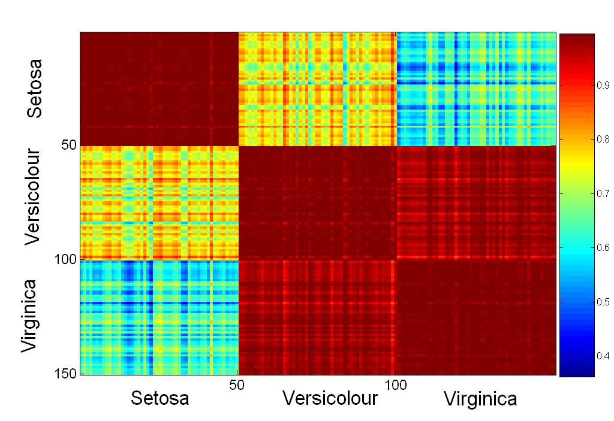
Visualization of the Iris Correlation Matrix

Slide 29
Thank You!
In our next segment: Software Infrastructure

Slide 30
In this segment
Software Tools for ML
Notebooks and Colab
Python and important libraries
A few important functions
Missing data
Attribute Visualization
Data Cleaning
Attribute Combination
Handling categorical attributes
Test dataset Creation

Slide 31
Prerequisites
Jupyter Notebook
Open-source web application to create and share live code, equations, visualizations and narrative text.
Used for data cleaning and transformation, numerical simulation, statistical modeling, data visualization, machine learning, and much more.
Easy to tinker with code and execute it in steps
Run in local browser: https://jupyter.org/try
Local installation: https://jupyter.org/install.html
Repository of Jupyter Notebooks: https://github.com/ageron/handson-ml
Colab
Google’s flavor of Jupyter notebooks tailored for machine learning and data analysis
Runs entirely in the cloud.
free access to hardware accelerators like GPUs and TPUs (with some restrictions).
http://colab.research.google.com
Popular Datasets
UC Irvine Machine Learning Repository: http://archive.ics.uci.edu/ml/
Kaggle datasets: https://www.kaggle.com/datasets
Amazon’s AWS datasets: http://aws.amazon.com/fr/datasets/

Slide 32
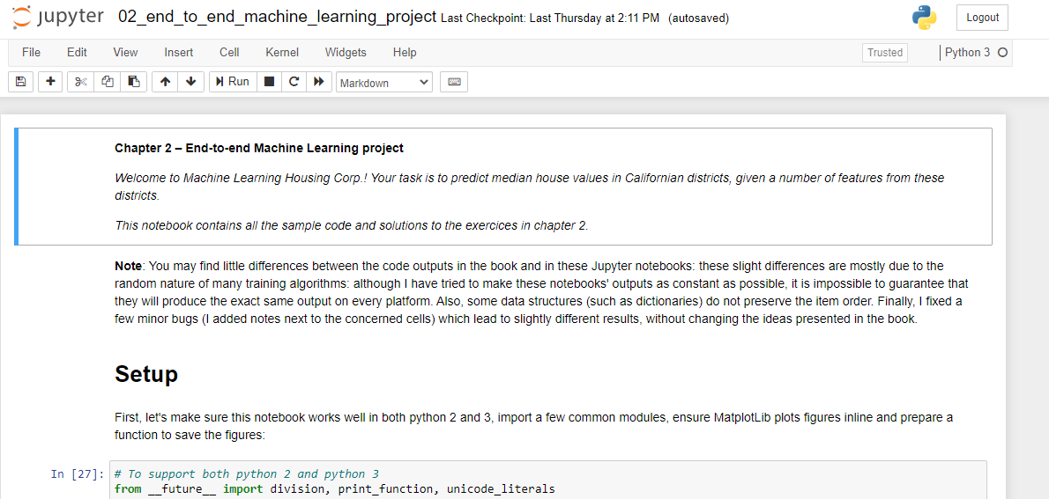
Local Installation
Preferred Mode
Install a virtual environment via Anaconda
Free Anaconda Python distribution: https://www.anaconda.com/products/individual
Download Python 3.* version

Slide 33
Prerequisites
Python and several scientific libraries
Python
high-level, dynamically typed multiparadigm programming language.
almost like pseudocode, very readable
Platform: Linux/Windows/MacOS
Documentation: https://www.python.org/doc/
Interactive Python tutorial: http://learnpython.org/
Stand alone installation: (preferably 3.7 or higher) https://www.python.org/downloads/
scikit-learn
Open source library that supports supervised and unsupervised learning.
Various model fitting, data preprocessing, model selection and evaluation tools, and other utilities.
Platform: Linux/Windows/MacOS
User guide: https://scikit-learn.org/stable/user_guide.html
Stand alone installation: https://scikit-learn.org/stable/install.html

Slide 34
Prerequisites
Important libraries
Numpy
Scientific computing library with Python
Provides high-performance multidimensional array (e.g., vector, matrix) and basic tools to compute with and manipulate these arrays, linear algebra, random number generators
https://numpy.org/doc/stable/reference/
https://numpy.org/install/
SciPy
Builds on numpy, provides functions that operate on numpy arrays
Useful for different types of scientific and engineering applications, integration, image processing, …
https://docs.scipy.org/doc/scipy/reference/tutorial/index.html
Standalone installation: https://scipy.org/install.html
Matplotlib
Plotting library
https://matplotlib.org/
https://matplotlib.org/tutorials/index.html
https://matplotlib.org/users/installing.html

Slide 35
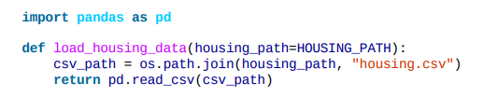
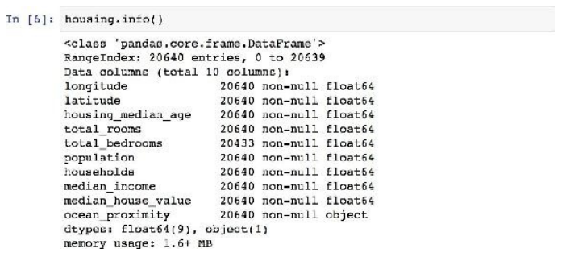
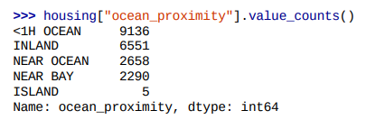
Important ML Steps and Functions
https://github.com/ageron/handson-ml/blob/master/02_end_to_end_machine_learning_project.ipynb
20,640 data instances in the dataset – fairly small
207 districts are missing total_bedrooms attribute
except ocean_proximity, rest of the attributes numerical
type of ocean_proximity is object, so it must be a text attribute - a repeated categorical attribute!

Slide 36
Important ML Steps and Functions
20,640 data instances in the dataset – fairly small
207 districts are missing total_bedrooms attribute
except ocean_proximity, rest of the attributes numerical
type of ocean_proximity is object, so it must be a text attribute - a repeated categorical attribute!

Slide 37
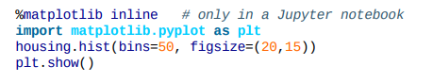
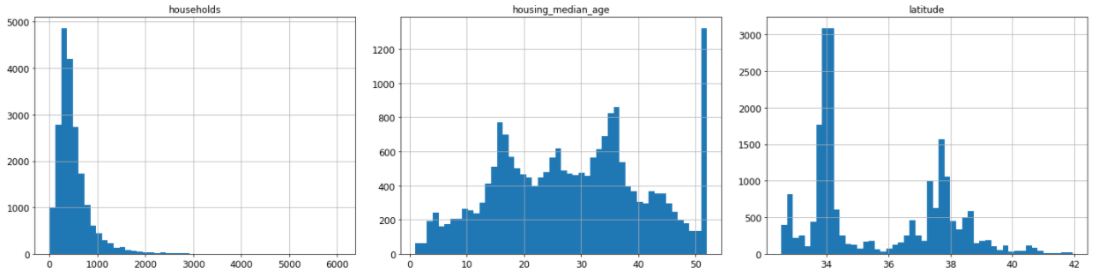
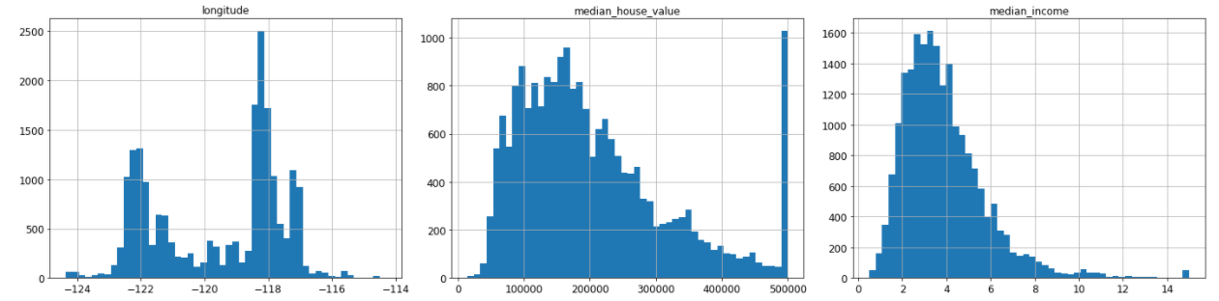
Attribute Visualization
age
latitude
# of households
longitude
price
income

Slide 38
Observations from Histogram
Median income attribute not expressed in US dollars (USD).
scaled and capped at 15 for higher median incomes, and at 0.5 for lower median incomes.
The housing median age and the median house value also capped.
Machine Learning algorithms may learn that prices never go beyond that limit.
If precise predictions even beyond $500,000 is needed
Collect proper labels for the districts whose labels were capped.
Remove those districts from the training set and also from the test set
Attributes have very different scales.
Finally, many histograms are tail heavy.
Transformation may be needed on to have more bell-shaped distributions

Slide 39
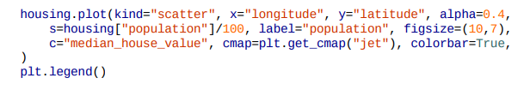
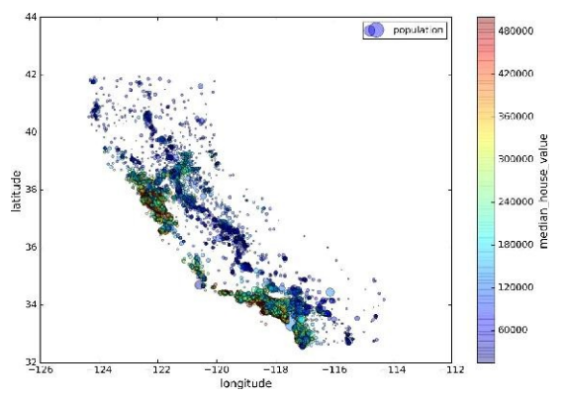
Visualizing Training Data for Insights

Slide 40
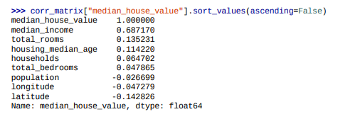
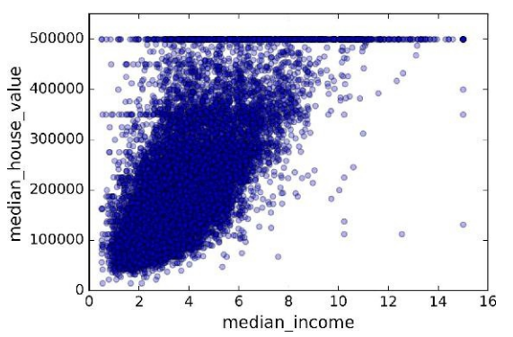
Correlations in Training Data
House prices are strongly correlated with income
small negative correlation between the latitude and the median house value
i.e., prices have a slight tendency to go down when you go north)
price cap clearly visible as a horizontal line at $500K.
Additional horizontal lines around $450k, $350K, perhaps one around $280K, ...

Slide 41
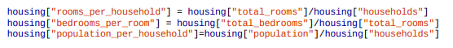
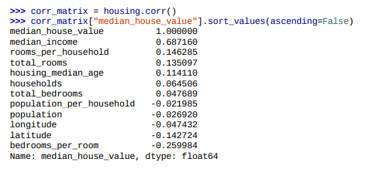
Experimenting with Attribute Combinations
Total number of rooms in a district not very useful
What may be important is the number of rooms per household.
Similarly, the total number of bedrooms compared to the number of rooms may be more meaningful
rooms_per_household is more correlated with price than total number of bedrooms or rooms.

Slide 42
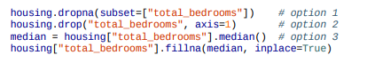
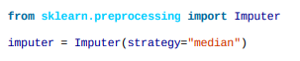
Data Cleaning
Some of the instances don’t have total_bedroom values
Imputer utility in scikit-learn
Since median applies only to numerical data, create an copy of the data without ocean-proximity
The imputer stores the median of each attribute the result in its statistics_ instance variable.
Use this “trained” imputer to replace any missing values by the learned medians

Slide 43
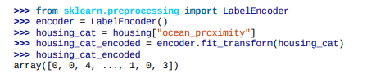
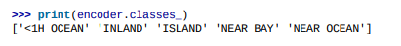
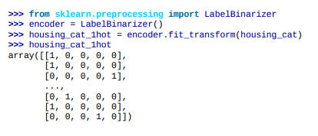
Handling Textual and Categorical Data
Convert the text attributes to numbers
Scikit-learn provides a transformer
ML algorithms assume closer values are more similar. But ‘<1H OCEAN’ and ‘NEAR OCEAN’ are far away in values!
Solution! Use 1-hot encoding

Slide 44
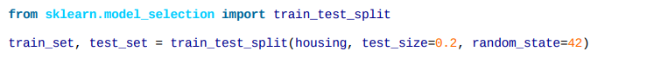
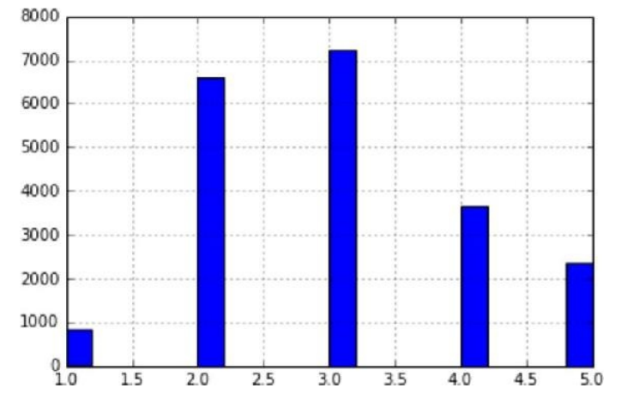
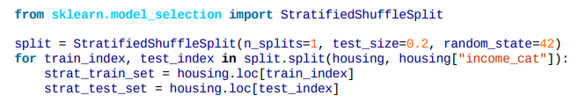
Test Set Creation
Ensures reproducibility of results
Test set size is 20% of training set
Uses uniform sampling of data.
Not appropriate for heavy tailed distribution
income very important to predict house prices.
Important that test set is representative of the various categories of incomes in the dataset.
Most income values are around $20–$50K, but some >> $60K.
Histogram of income categories

Slide 45
Thank You!
In our next segment: Model Building

Slide 46
In This Segment
Model Selection and Training
For regression problem
For classification problem
Multi-class classification
Multi-output classification

Slide 47
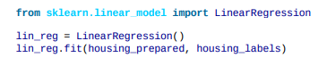
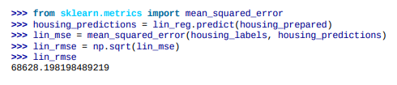
Model Selection and Training
Select based on training data
If prediction label/output is available, use regression or classification model
Regression if real valued output
Classification if output is discrete (binary/integer)
else, unsupervised model is used.
For the house price prediction problem, use regression model since median house prices are available along with training data (predictors)
Example: Linear Regression
Better model is necessary for improving the prediction accuracy

Slide 48
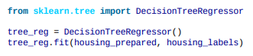
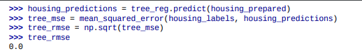
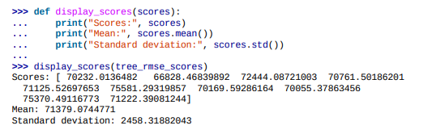
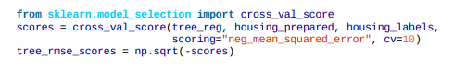
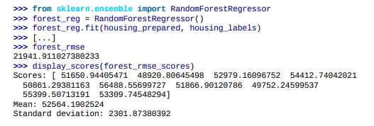
Regression Model Selection and Training
Decision Tree Based Regression produces low error on training data
Cross-validation error is not satisfactory
Better accuracy can be obtained using Random Forest based regressor

Slide 49
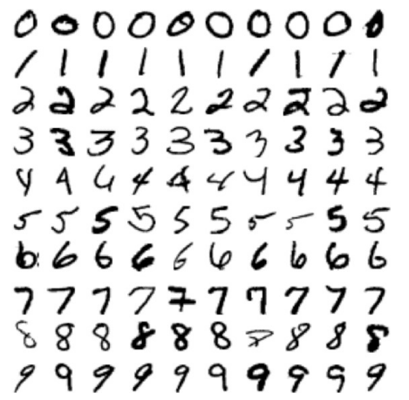
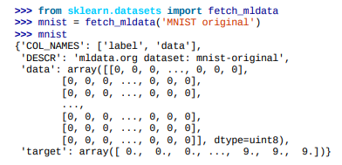



Classification Model
MNIST Dataset Classification
A set of 70,000 small images of handwritten digits
Each image 28x28 pixel with intensity 0 (black) – 255 (white)
Input data represented as 70000 x 784 matrix
Each image is labeled with the digit it represents.

Slide 50



Classification Model Training
Detect a ‘5’
Segment the dataset into 60,000 training images and 10,000 test images
Shuffle the training dataset
Train a classification model for detecting ‘5’. Target output for training data instance corresponding an image of ‘5’ is +1, else target output is ‘0’
Perform cross validation like the regression problem and try out multiple classification model for achieving acceptable performance.

Slide 51
Multiclass Classification
Multiclass classifiers (aka multinomial classifiers) can distinguish between more than two classes.
Some algorithms (such as Random Forest classifiers or naive Bayes classifiers) are capable of handling multiple classes directly.
Many (such as Support Vector Machine classifiers or Linear classifiers) are strictly binary
One-versus-all (OvA) or One-versus-rest strategy using multiple binary classifiers.
e.g., for MNIST classification, train 10 binary classifiers, one for each digit (a 0-detector, a 1-detector, a 2-detector, and so on).
get the decision score from each classifier for that image and select the class whose classifier outputs the highest score.
One-versus-one (OvO) strategy
train a binary classifier for every pair of digits: one to distinguish 0s and 1s, another to distinguish 0s and 2s, another for 1s and 2s, and so on.
If there are N classes, you need to train N × (N – 1) / 2 classifiers.
Run an image through all 45 classifiers and see which class wins the most duels.
Main advantage of OvO is each classifier only needs to be trained on the part of the training set for the two classes that it must distinguish

Slide 52
Multi Label / Output Classification
In multilabel classification, multiple classes for each instance should be output.
e.g., the classifier has been trained to recognize three faces, A, B, and C; then when it is shown a picture of A and C, it should output [1, 0, 1]
In multioutput-multiclass or simply multioutput classification each label can be multiclass, i.e., it can have more than two possible values.
e.g., in a system to remove noise from images, input is a noisy digit image, output a clean digit image, represented as an array of pixel intensities
classifier’s output is multilabel - one label per pixel
each label can have multiple values (pixel intensity ranges from 0 to 255

Slide 53
Thank You!
In our next segment: Model Evaluation

Slide 54
Model Evaluation
Metrics for Performance Evaluation
How to evaluate the performance of a model?
Methods for Performance Evaluation

Slide 55
Metrics for Performance Evaluation
Focus on the predictive capability of a model
Confusion Matrix
 | PREDICTED CLASS
ACTUAL CLASS |  | Class=Yes | Class=No
 | Class=Yes | a | b
 | Class=No | c | d
a: TP (true positive)
b: FN (false negative)
c: FP (false positive)
d: TN (true negative)

Slide 56
Metrics for Performance Evaluation…
 | PREDICTED CLASS
ACTUAL CLASS |  | Class=Yes | Class=No
 | Class=Yes | a (TP) | b (FN)
 | Class=No | c (FP) | d (TN)
Most widely-used metric:

Slide 57
Limitation of Accuracy
Consider a 2-class problem
Number of Class 0 examples = 9990
Number of Class 1 examples = 10
If model predicts everything to be class 0, accuracy is 9990/10000 = 99.9 %
Accuracy is misleading because model does not detect any class 1 example

Slide 58
Cost Matrix
 | PREDICTED CLASS
ACTUAL CLASS | C(i | j) | Class=Yes | Class=No
 | Class=Yes | C(Yes|Yes) | C(No|Yes)
 | Class=No | C(Yes|No) | C(No|No)
C( i | j ): Cost of misclassifying class j example as class i

Slide 59
Computing Cost of Classification
Cost Matrix | PREDICTED CLASS
ACTUAL CLASS | C(i|j) | + | -
 | + | -1 | 100
 | - | 1 | 0
Model M₁ | PREDICTED CLASS
ACTUAL CLASS |  | + | -
 | + | 150 | 40
 | - | 60 | 250
Model M₂ | PREDICTED CLASS
ACTUAL CLASS |  | + | -
 | + | 250 | 45
 | - | 5 | 200
Accuracy = 80%
Cost = 3910
Accuracy = 90%
Cost = 4255

Slide 60
Cost vs Accuracy
Count | PREDICTED CLASS
ACTUAL CLASS |  | Class=Yes | Class=No
 | Class=Yes | a | b
 | Class=No | c | d
Accuracy is proportional to cost if 1. C(Yes|No)=C(No|Yes) = q 2. C(Yes|Yes)=C(No|No) = p
N = a + b + c + d
Accuracy = (a + d)/N
Cost = p (a + d) + q (b + c)
= p (a + d) + q (N – a – d)
= q N – (q – p)(a + d)
= N [q – (q-p) × Accuracy]
Cost | PREDICTED CLASS
ACTUAL CLASS |  | Class=Yes | Class=No
 | Class=Yes | p | q
 | Class=No | q | p

Slide 61
Measures for Imbalanced Classes

Slide 62
Methods for Performance Evaluation
How to obtain a reliable estimate of performance?
Performance of a model may depend on other factors besides the learning algorithm:
Class distribution
Cost of misclassification
Size of training and test sets

Slide 63

Learning Curve
Learning curve shows how accuracy changes with varying sample size
Requires a sampling schedule for creating learning curve:
Arithmetic sampling (Langley, et al)
Geometric sampling (Provost et al)
Effect of small sample size:
Bias in the estimate
Variance of estimate

Slide 64
Methods of Estimation
Holdout
Reserve 2/3 for training and 1/3 for testing
Random subsampling
Repeated holdout
Cross validation
Partition data into k disjoint subsets
k-fold: train on k-1 partitions, test on the remaining one
Leave-one-out: k=n
Stratified sampling
oversampling vs undersampling
Bootstrap
Sampling with replacement

Slide 65
ROC (Receiver Operating Characteristic)
Developed in 1950s for signal detection theory to analyze noisy signals
Characterize the trade-off between positive hits and false alarms
ROC curve plots TP (on the y-axis) against FP (on the x-axis)
Performance of each classifier represented as a point on the ROC curve
changing the threshold of algorithm, sample distribution or cost matrix changes the location of the point

Slide 66


ROC Curve
1-dimensional data set containing 2 classes (positive and negative)
any points located at x > t is classified as positive
At threshold t:
TP=0.5, FN=0.5, FP=0.12, TN=0.88

Slide 67
ROC Curve
(TP,FP):
(0,0): declare everything to be negative class
(1,1): declare everything to be positive class
(1,0): ideal
Diagonal line:
Random guessing
Below diagonal line:
prediction is opposite of the true class

Slide 68

Using ROC for Model Comparison
No model consistently outperform the other
M₁ is better for small FPR
M₂ is better for large FPR
Area Under the ROC curve
Ideal:
Area = 1
Random guess:
Area = 0.5

Slide 69
How to Construct an ROC curve
Instance | P(+|A) | True Class
1 | 0.95 | +
2 | 0.93 | +
3 | 0.87 | -
4 | 0.85 | -
5 | 0.85 | -
6 | 0.85 | +
7 | 0.76 | -
8 | 0.53 | +
9 | 0.43 | -
10 | 0.25 | +
Use classifier that produces posterior probability for each test instance P(+|A)
Sort the instances according to P(+|A) in decreasing order
Apply threshold at each unique value of P(+|A)
Count the number of TP, FP, TN, FN at each threshold
TP rate, TPR = TP/(TP+FN)
FP rate, FPR = FP/(FP + TN)

Slide 70

How to construct an ROC curve
ROC Curve:
Threshold >=

Slide 71
Test of Significance
Given two models:
Model M1: accuracy = 85%, tested on 30 instances
Model M2: accuracy = 75%, tested on 5000 instances
Can we say M1 is better than M2?
How much confidence can we place on accuracy of M1 and M2?
Can the difference in performance measure be explained as a result of random fluctuations in the test set?

Slide 72
Confidence Interval for Accuracy
Prediction can be regarded as a Bernoulli trial
A Bernoulli trial has 2 possible outcomes
Possible outcomes for prediction: correct or wrong
Collection of Bernoulli trials has a Binomial distribution:
x ∼ Bin(N, p) x: number of correct predictions
e.g: Toss a fair coin N=50 times, how many heads would turn up? Expected number of heads = N×p = 50 × 0.5 = 25
Given x (# of correct predictions) or equivalently, acc=x/N, and N (# of test instances), Can we predict p (true accuracy of model)?

Slide 73

Confidence Interval for Accuracy
Area = 1 - α
For large test sets (N > 30),
acc has a normal distribution with mean p and variance p(1-p)/N
Confidence Interval for p:
Z_{α/2}
Z_{1- α /2}

Slide 74
Confidence Interval for Accuracy
Consider a model that produces an accuracy of 80% when evaluated on 100 test instances:
N=100, acc = 0.8
Let 1-α = 0.95 (95% confidence)
From probability table, Z_{α/2}=1.96
1-α | Z
0.99 | 2.58
0.98 | 2.33
0.95 | 1.96
0.90 | 1.65
N | 50 | 100 | 500 | 1000 | 5000
p(lower) | 0.670 | 0.711 | 0.763 | 0.774 | 0.789
p(upper) | 0.888 | 0.866 | 0.833 | 0.824 | 0.811

Slide 75
Comparing Performance of Two Models
Given two models, say M1 and M2, which is better?
M1 is tested on D1 (size=n1), found error rate = e₁
M2 is tested on D2 (size=n2), found error rate = e₂
Assume D1 and D2 are independent
If n1 and n2 are sufficiently large, then
Approximate:

Slide 76
Comparing Performance of Two Models
To test if performance difference is statistically significant: d = e1 – e2
d ~ N(d_{t},σ_{t}) where d_{t} is the true difference
Since D1 and D2 are independent, their variance adds up:
At (1-α) confidence level,

Slide 77
An Illustrative Example
Given: M1: n1 = 30, e1 = 0.15 M2: n2 = 5000, e2 = 0.25
d = |e2 – e1| = 0.1 (2-sided test)
At 95% confidence level, Z_{α/2}=1.96 => Interval contains 0 => difference may not be statistically significant

Slide 78
Comparing Performance of Two Algorithms
Each learning algorithm may produce k models:
L1 may produce M11 , M12, …, M1k
L2 may produce M21 , M22, …, M2k
If models are generated on the same test sets D1,D2, …, Dk (e.g., via cross-validation)
For each set: compute d_{j} = e_{1j} – e_{2j}
d_{j} has mean d_{t} and variance σ_{t}
Estimate:

Slide 79
Thank You!
In our next segment: Hyperparameter Optimization

Slide 80
Hyperparameter optimization
Dr. Sugata Ghosal
sugata.ghosal@pilani.bits-pilani.ac.in

Slide 81
Hyperparameters
Machine Learning systems use many parameters internally
Gradient Descent
e.g., Learning rate, how long to run
Mini-batch
Batch size
Regularization constant
Many Others
will be discussed in upcoming sessions

Slide 82
From Theory
Theoretical analysis of some class of problems gives us a recipe for assigning hyperparameters
Also gives guarantees that the algorithm will converge with some optimal rate
This is usually enough to get an asymptotically optimal rate
Certainly in the worst case

Slide 83
Hyperparameter Optimization
Also called metaparameter optimization
Also called tuning
How to find best values of hyperparameters?

Slide 84
Tuning By Hand
Just fiddle with the parameters until you get the results you want
Probably the most common type of hyperparameter optimization
Upsides: the results are generally pretty good…
Downsides: lots of effort, and no theoretical guarantees

Slide 85

Grid Search
Define some grid of parameters you want to try
Try all the parameter values in the grid
By running the whole system for each setting of parameters
Then choose the setting with the best result
Essentially a brute force method

Slide 86
Downsides of Grid Search
As the number of parameters increases, the cost of grid search increases exponentially!
Need some way to choose the grid properly
Something this can be as hard as the original hyperparameter optimization
Can’t take advantage of any insight you have about the system!

Slide 87
Making Grid Search Fast
Early stopping to the rescue
Can run all the grid points for one epoch, then discard the half that performed worse, then run for another epoch, discard half, and continue.
Can take advantage of parallelism
Run all the different parameter settings independently on different servers in a cluster.
An embarrassingly parallel task.
Downside: doesn’t reduce the energy cost.

Slide 88
One Variant: Random Search
This is just grid search, but with randomly chosen points instead of points on a grid.
RandomSearchCV
This solves the curse of dimensionality
Don’t need to increase the number of grid points exponentially as the number of dimensions increases.
Problem: with random search, not necessarily going to get anywhere near the optimal parameters in a finite sample.

Slide 89
One Variant: Best Ball
Works with epochs.
At each epoch, do a small grid search around the current hyperparameter settings
Then evaluate the objective and choose the “best ball”
The choice of parameters that gave the best objective for that epoch
And repeat until a solution of desired quality is achieved.

Slide 90
An Alternative: Bayesian Optimization
Statistical approach for minimizing noisy black-box functions.
Idea: learn a statistical model of the function from hyperparameter values to the loss function
Then choose parameters to minimize the loss
Main benefit: choose the hyperparameters to test not at random, but in a way that gives the most information about the model
This lets it learn faster than grid search

Slide 91
Effect of Bayesian Optimization
Downside: it’s a pretty heavyweight method
The updates are not as simple-to-implement as grid search
Upside: empirically it has been demonstrated to get better results in fewer experiments
Compared with grid search and random search
Pretty widely used method
Lots of research opportunities here.

Slide 92
A related method: Derivative Free Optimization
Derivative-free optimization
Also called zeroth-order optimization
These methods optimize a function using only evaluations, no derivatives
Ideal for use with metaparameter optimization
Also ideal for reinforcement learning

Slide 93
The opposite of DFO: Gradient-based Optimization
These strategies say: “I’m doing SGD to learn, I may as well use it to optimize my hyperparameters.”
When we can efficiently differentiate with respect to the hyperparameters, this strategy actually works pretty well.
But generally, we can’t do it.

Slide 94
Methods that Look at the Data
Many methods look at curvature/variance info to decide how to set hyperparameters, and update their settings throughout the algorithm
Example: ADAGRAD
Example: Adam
Which you will be reading in a few weeks.

Slide 95
How to evaluate the hyperparameters?
Unlike the model parameters, we’re not given a loss function
Can’t we just use the training loss?
Not always: we don’t want to overfit the hyperparameters
Especially not when they are things that affect the model

Slide 96
Cross-Validation
Partition part of the available data to create an validation dataset that we don’t use for training.
Then use that set to evaluate the hyperparameters.
Typically, multiple rounds of cross-validation are performed using different partitions
Can get a very good sense of how good the hyperparameters are
But at a significant computational cost!

Slide 97
Thank You!
In our next segment: Machine Learning Pipeline

Slide 98
Machine Learning Pipeline
Dr. Sugata Ghosal
sugata.ghosal@pilani.bits-pilani.ac.in

Slide 99
In This Segment
What is MLOps
DevOps vs MLOps
Level 0 MLOps
Continuous Training
Level 1 MLOps
Continuous Integration, Delivery
Frameworks

Slide 100
What is MLOps?
Apply DevOps principles to ML systems
An engineering culture and practice that aims at unifying ML system development (Dev) and ML system operation (Ops).
Automation and monitoring at all steps of ML system construction, including integration, testing, releasing, deployment and infrastructure management.
Data scientists can implement and train an ML model with predictive performance on an offline validation (holdout) dataset, given relevant training data for their use case.
However, the real challenge is building an integrated ML system and to continuously operate it in production.

Slide 101

Ecosystem of ML System Components
A small fraction of a real-world ML system is composed of the ML code

Slide 102
DevOps Vs. MLOps
DevOps for developing and operating large-scale software systems provides benefits such as
shortening the development cycles
increasing deployment velocity, and
dependable releases.
Two key concepts
Continuous Integration (CI)
Continuous Delivery (CD)
An ML system is a software system, so similar practices apply to reliably build and operate at scale.
However, ML systems differ from other software systems
Team skills: focus on exploratory data analysis, model development, and experimentation.
Development: ML is experimental in nature.
The challenge is tracking what worked and what did not, maintaining reproducibility, and maximizing code reusability.
Testing: Additional testing needed for data validation, trained model quality evaluation, and model validation.

Slide 103
DevOps Vs. MLOps
Deployment: a multi-step pipeline to automatically retrain and deploy model.
adds complexity
Automation needed before deployment by data scientists to train and validate new models.
Production: ML models can have reduced performance due to constantly evolving data profiles.
Need to track summary statistics of data and
monitor the online performance of model to send notifications or roll back for suboptimal values
ML and other software systems are similar in CI of source control, unit / integration testing, and CD of the software module / package.
However, in ML,
CI is also about testing and validating data, data schemas, and models.
CD is a system (an ML training pipeline) that automatically deploys another service (model prediction service).
Continuous training (CT) is a new property, unique to ML systems, that is concerned with automatically retraining the model in production and serving the models.

Slide 104

Manual ML Steps
Manual, script-driven, and interactive process.
Disconnection between ML and operations, possibly leading to training-serving skew
Infrequent release iterations. No CI, CD, active performance monitoring
Deploy trained Model as a prediction service
Deployment process is concerned only with deploying the trained model as a prediction service, e.g., a microservice with a REST API

Slide 105

MLOps Level 1
Perform continuous training (CT) by automating the ML pipeline
Achieves continuous delivery of model prediction service.
Automated data and model validation steps to the pipeline
Needs pipeline triggers and metadata management.

Slide 106
Data and Model Validation
Data validation: Required prior to model training to decide whether to retrain the model or stop the execution of the pipeline based on following
Data values skews: significant changes in the statistical properties of data, triggering retraining
Data schema skews: downstream pipeline steps, including data processing and model training, receives data that doesn't comply with the expected schema.
stop the pipeline to release a fix or an update to the pipeline to handle these changes in the schema.
Schema skews include receiving unexpected features or with unexpected values, not receiving all the expected features
Model validation: Required after retraining the model with the new data. Evaluate and validate the model before promoting to production. This offline model validation step consists of
Producing evaluation metric using the trained model on test data to assess the model quality.
Comparing the evaluation metrics of production model, baseline model, or other business-requirement models.
Ensuring the consistency of model performance on various data segments
Test model for deployment, including infrastructure compatibility and API consistency
Undergo online model validation—in a canary deployment or an A/B testing setup

Slide 107

Level 2: CI/CD and automated pipeline automation
Notes:
Enables rapid and reliable update of the pipelines in production.
Enables rapid exploration of new ideas around feature engineering, model architecture, and hyperparameters.
They can implement these ideas and automatically build, test, and deploy the new pipeline components to the target environment.

Slide 108
Stages of CI/CD Automation Pipeline
Development and experimentation: iteratively try new ML algorithms and modeling. The output is the source code of the ML pipeline steps that are then pushed to a source repository.
Pipeline continuous integration: build source code and run various tests. The outputs of this stage are pipeline components (packages, executables, and artifacts).
Pipeline continuous delivery: deploy artifacts produced by the CI stage to the target environment.
Automated training: automatically executed in production based on a schedule or trigger. The output is a trained model pushed to the model registry.
Model continuous delivery: serve the trained model as a prediction service for the predictions.
Monitoring: collect statistics on the model performance based on live data. The output is a trigger to execute the pipeline or to execute a new experiment cycle.

Slide 109

Stages of the CI/CD automated ML pipeline

Slide 110
Continuous Integration
Pipeline and its components are built, tested, and packaged when
new code is committed or
pushed to the source code repository.
Besides building packages, container images, and executables, CI process can include
Unit testing feature engineering logic.
Unit testing the different methods implemented in your model.
For example, you have a function that accepts a categorical data column and you encode the function as a one-hot feature.
Testing for training convergence
Testing for NaN values due to dividing by zero or manipulating small or large values.
Testing that each component in the pipeline produces the expected artifacts.
Testing integration between pipeline components.

Slide 111
Continuous Delivery
Continuously delivers new pipeline implementations to the target environment
prediction services of the newly trained model.
For rapid and reliable continuous delivery of pipelines and models, consider
Verifying the compatibility of the model with the target infrastructure
e.g., required packages are installed in the serving environment
Availability of memory, compute, and accelerator resources.
Testing the prediction service by calling the service API for the updated model
Testing prediction service performance, such as throughput, latency.
Validating the data either for retraining or batch prediction.
Verifying that models meet the predictive performance targets prior to deployment.
Automated deployment to a test environment, triggered by new code to the development branch.
Semi-automated deployment to a pre-production environment, triggered by code merging
Manual deployment to a production from pre-production.

Slide 112
Frameworks
Cloud Vendors are providing MLOps framework
https://cloud.google.com/solutions/machine-learning/mlops-continuous-delivery-and-automation-pipelines-in-machine-learning
Kubeflow and Cloud Build
Amazon AWS MLOps
Microsoft Azure MLOps

Slide 113
Thank You!
In our next segment: Linear Regression

